Slide 1
Decision Trees vs Neural Networks for Classification of Emotions from Text
A DATA MINING AND MACHINE LEARNING PROJECT

Slide 2
Introduction
Extracting emotions from text has many applications
Customer feedback analysis
Health monitoring
In this work I compare
Decision Trees
Random Forests
Neural Networks

Slide 3
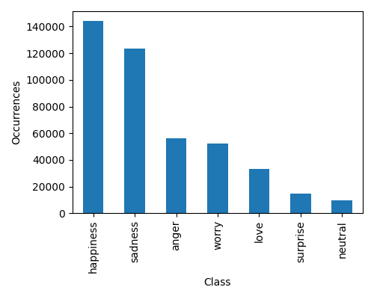
Data
Two datasets of labelled tweets were merged
CrowdFlower (40,000 instances)
Emotions (400,000 instances)
The resulting dataset has 7 emotions and is unbalanced
A weight for each class was used to train the models

Slide 4
Models
Three kinds of models were used
Decision Trees
Random Forests
Neural Networks

Slide 5
Decision Trees
Gini, entropy and log-loss criteria were tested
No post-pruning was used
max-depth and min-impurity-decreased used for regularization

Slide 6
Random Forests
Gini, entropy and log-loss criteria were tested
Up to 150 estimators were used
No post-pruning was used
max-depth and min-impurity-decreased used for regularization

Slide 7
Neural Networks
Dense networks and LSTM networks were tested
Dropout and Batch Normalization regularization techniques were used
Various combinations of network depth and size were tested
Both pretrained and non-pretrained embeddings were tested

Slide 8
Model Selection
Random search was used
Two generations of 10 models for each kind were tested

Slide 9
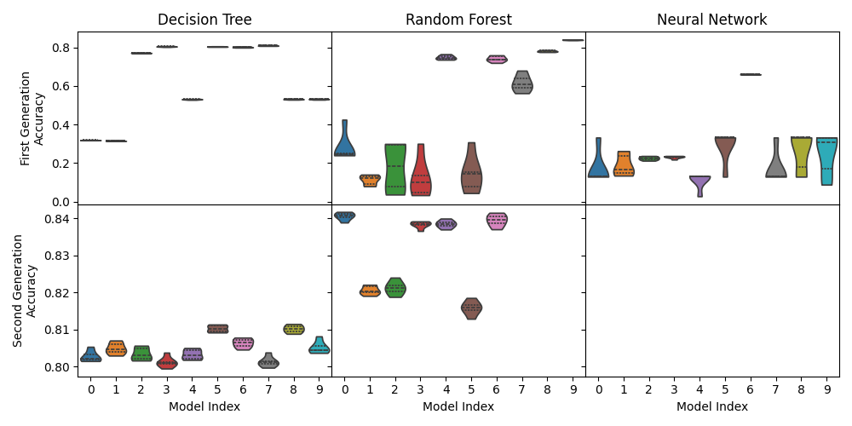
Results

Slide 10
Best model for each kind
Model name | Mean Accuracy
decision tree-G1-5 | 81.02%
random forest-G1-0 | 84.06%
neural network-G0-6 | 66.06%

Slide 11

The best model
random forest-G1-0 was the best model overall with 84.06% accuracy
It has 125 estimators
Uses the Gini index as criterion
Has no max-depth
Has min-impurity-decrease equal to ${10}^{−6}$

Slide 12

Other good models
Some models performed not statistically different from the best model
The Wilcoxon Signed Rank test with $p>0.05$ was used
They are all Random Forest with parameters almost identical to the best one

Slide 13
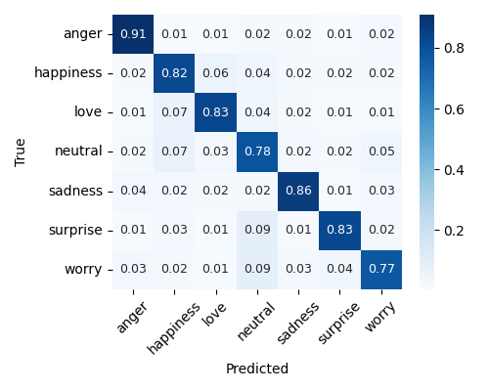
random forest-G1-0 confusion matrix

Slide 14
Comparison with Batbaatar et al.
We can compare the results with those of Batbaatar et al. (51.1% accuracy) on the CrowdFlower dataset
The best model had only 34.50% of accuracy on the CrowdFlower dataset
This difference can be traced to the complexity of the model used by Batbaatar et al. that uses a combination of LSTM and CNN

Slide 15
Conclusion
Random forests have proven to be easier to train than neural networks
The work could be improved with more computational resources to test more models and more complex neural networks

